Slide 1
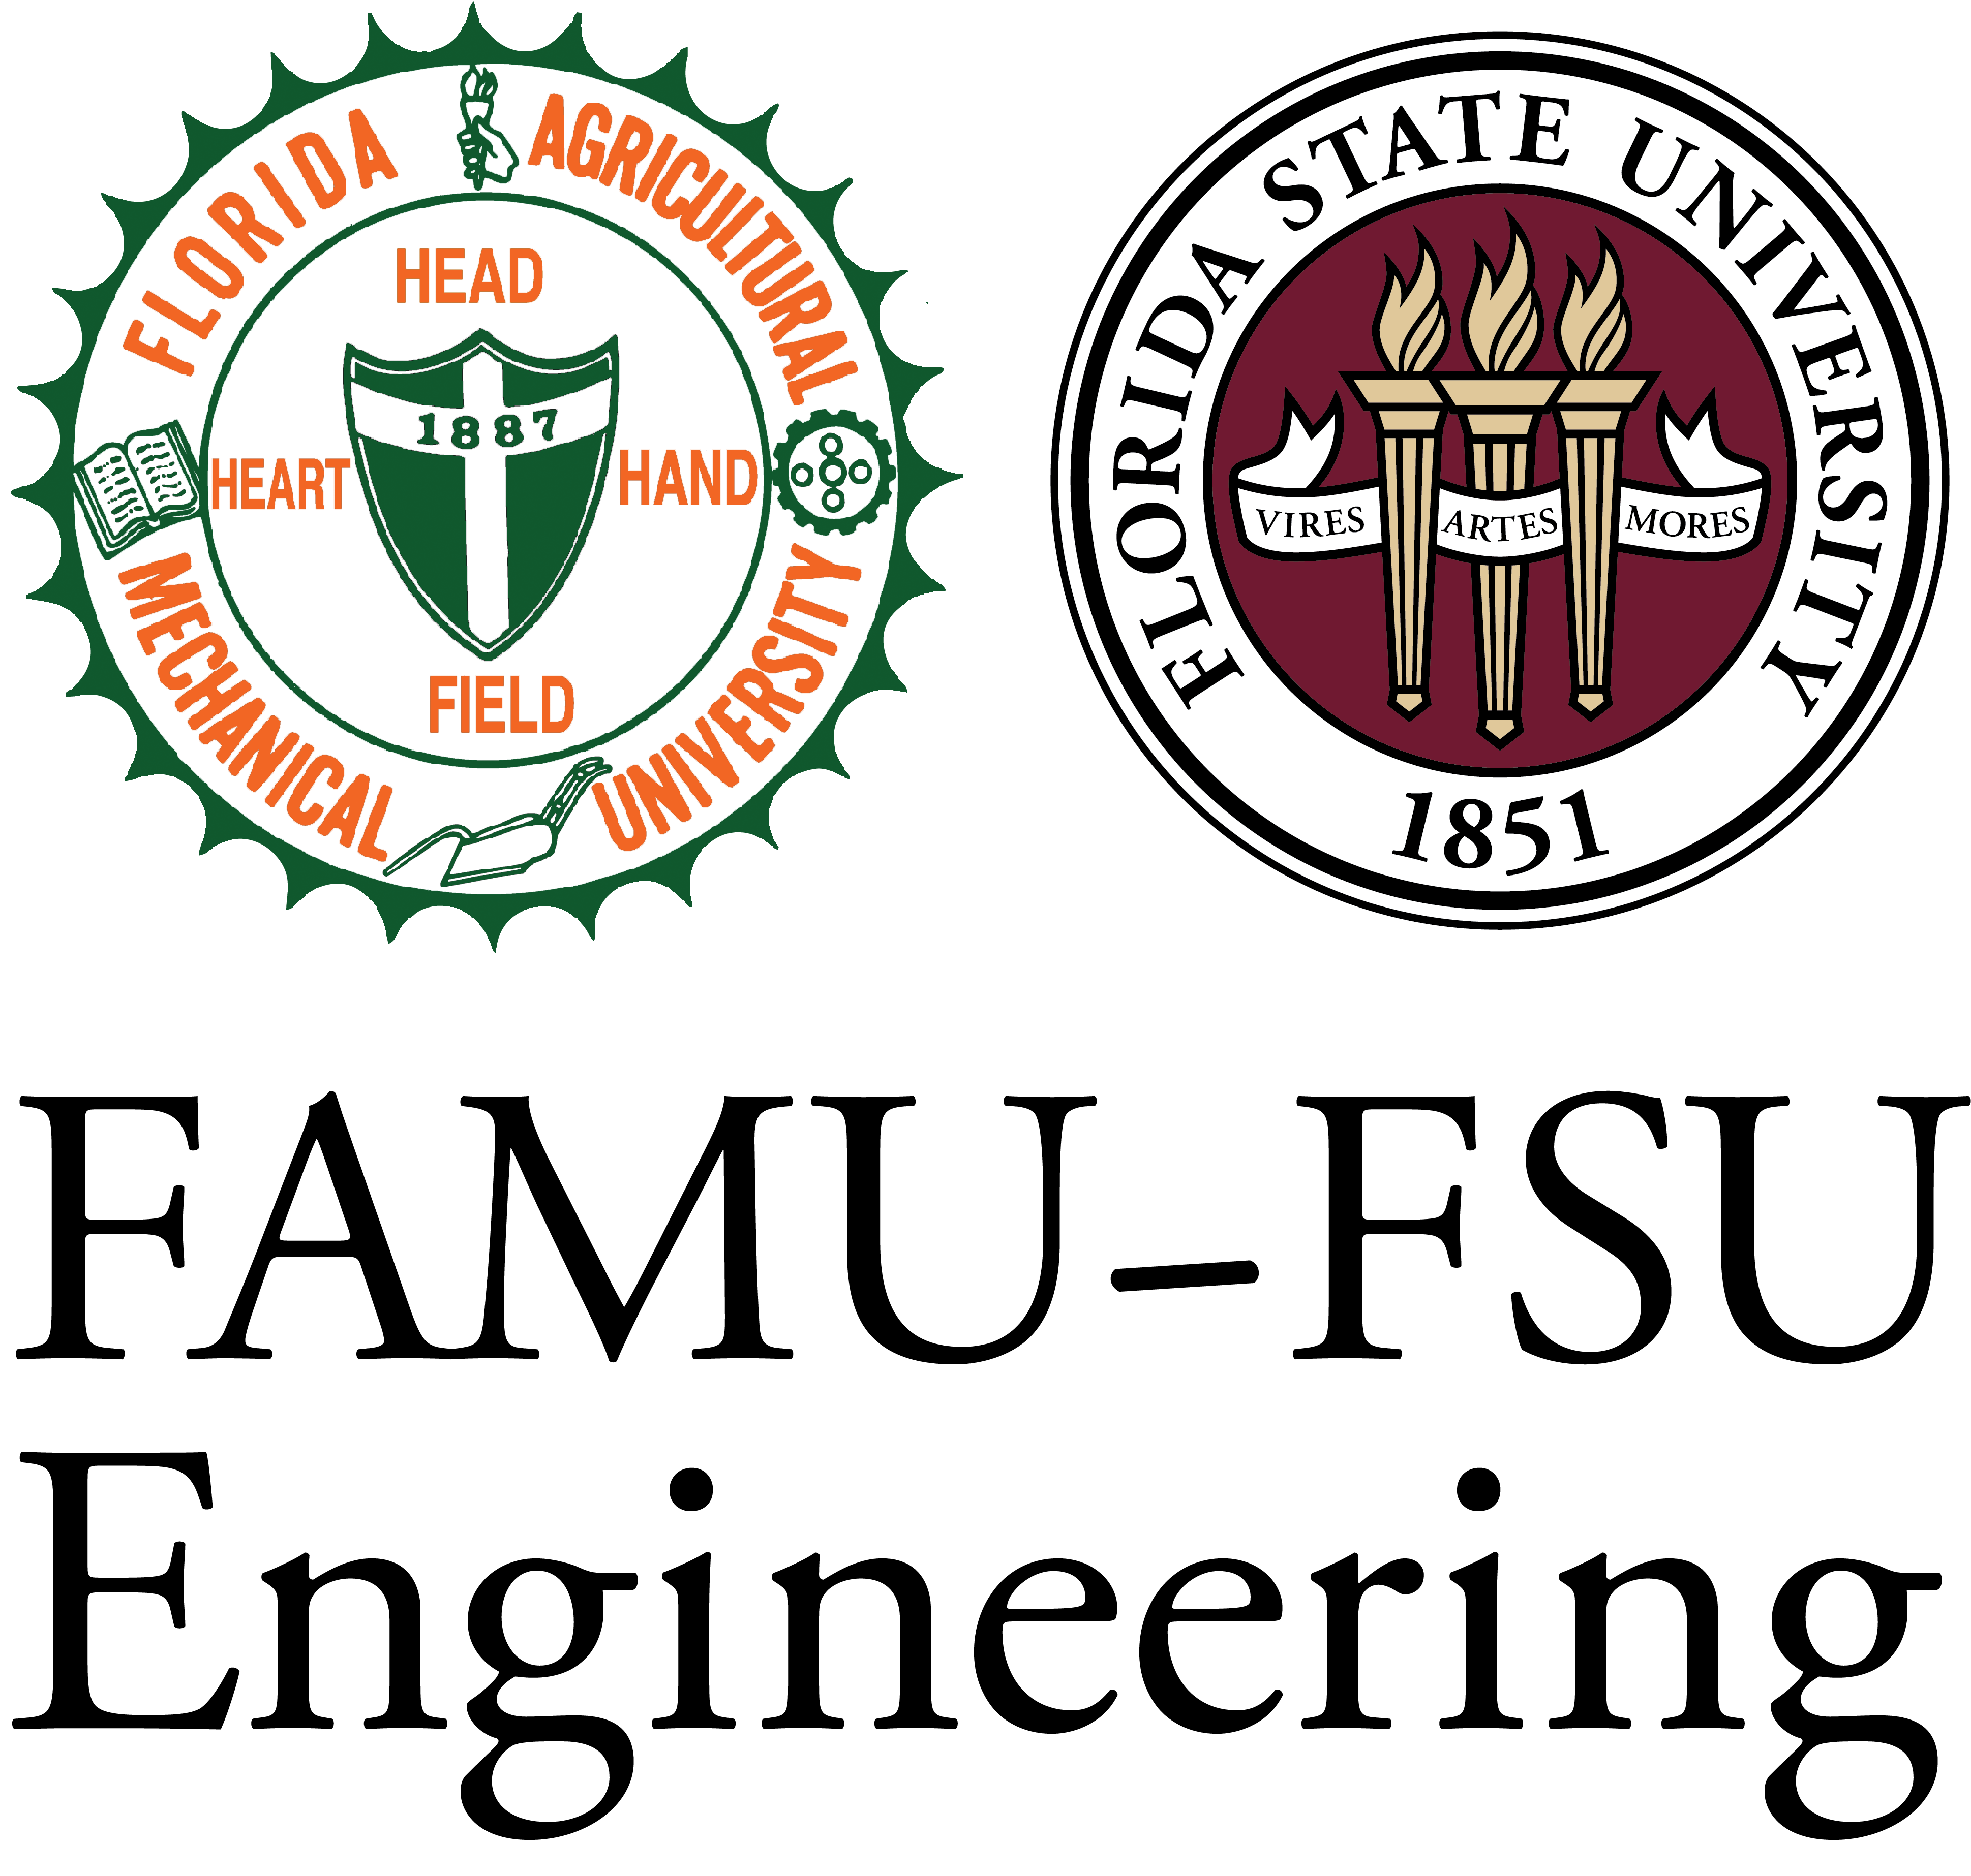
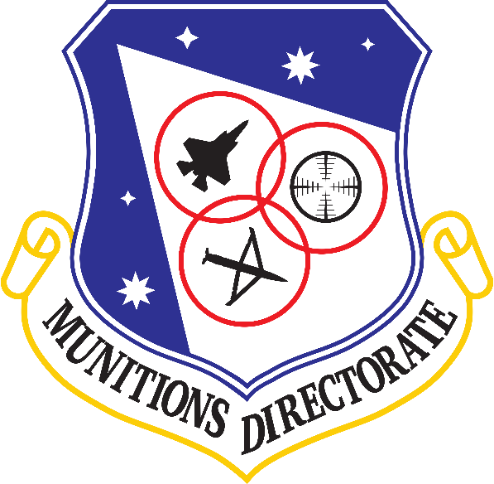
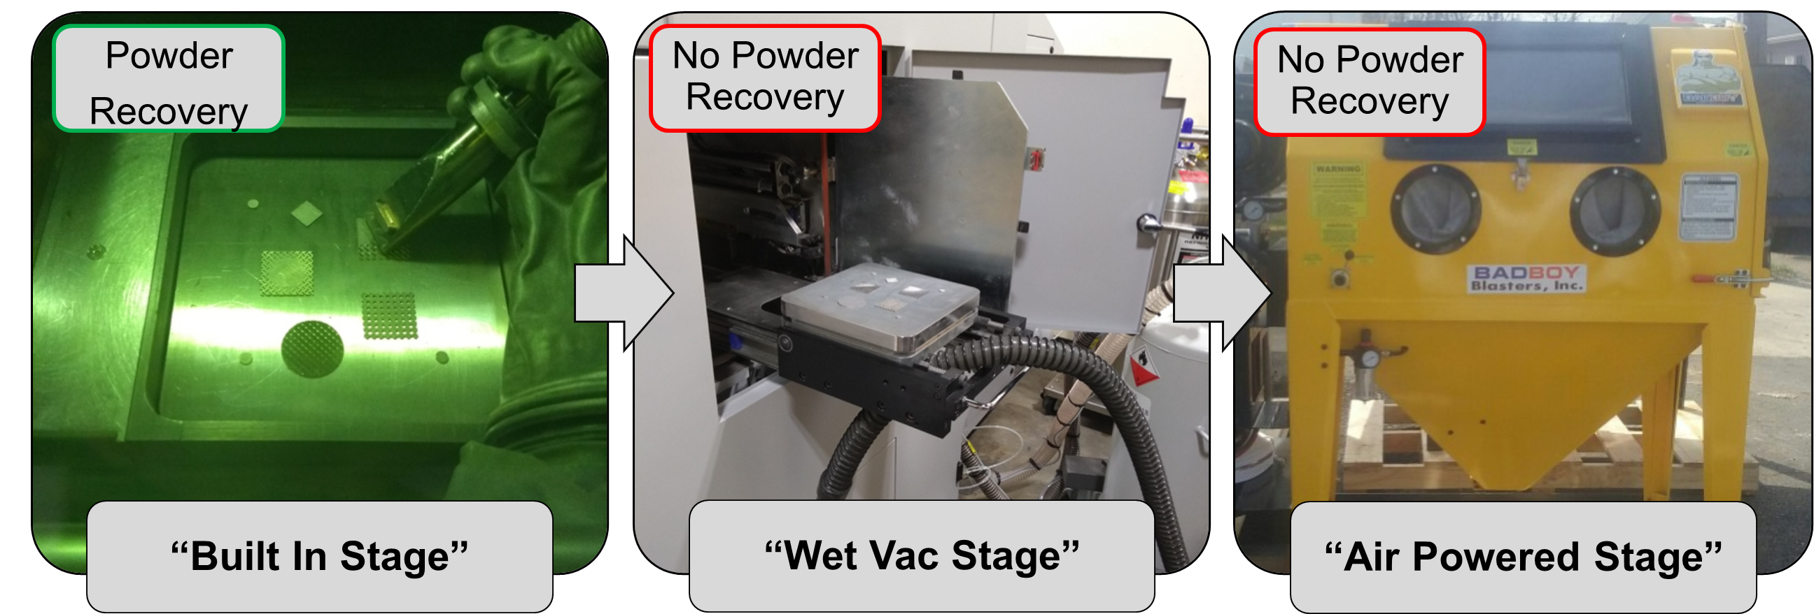
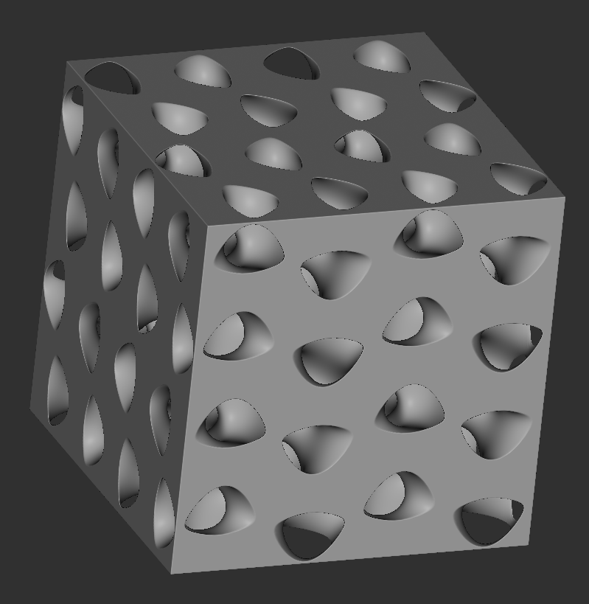
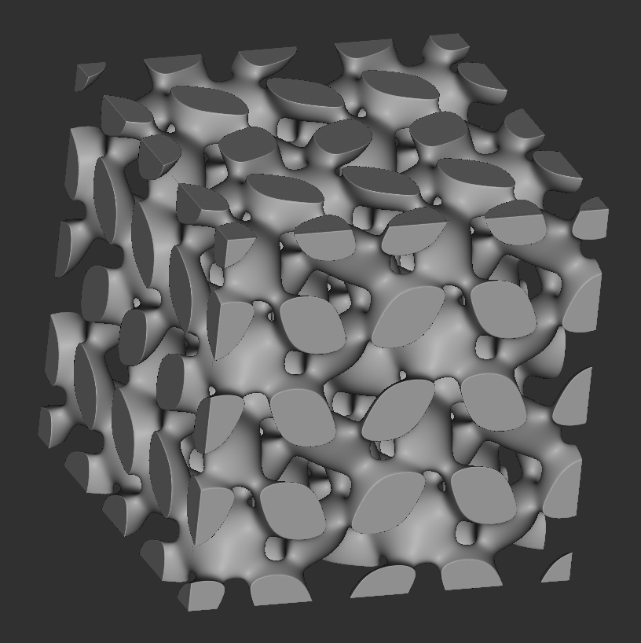
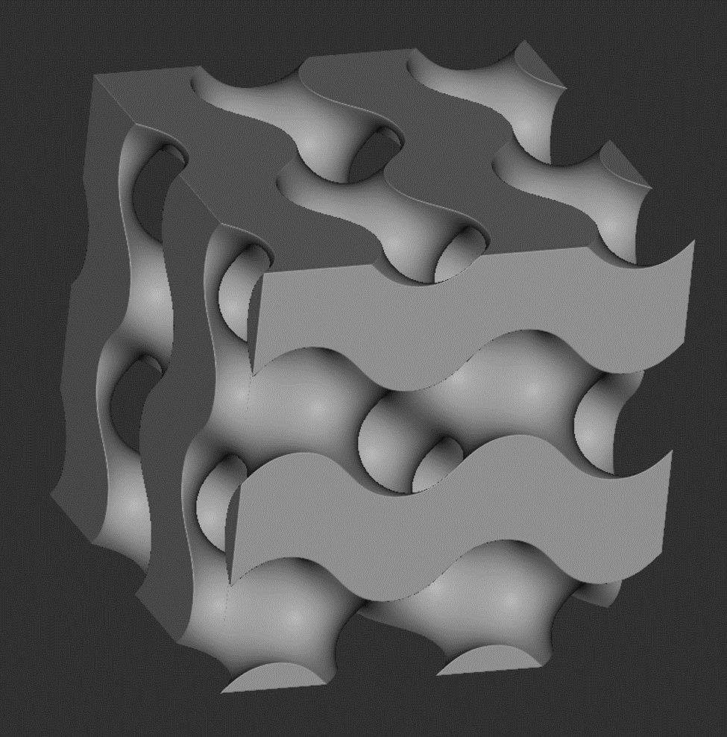
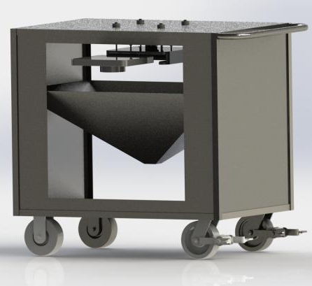
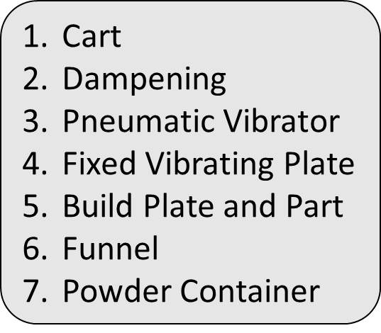
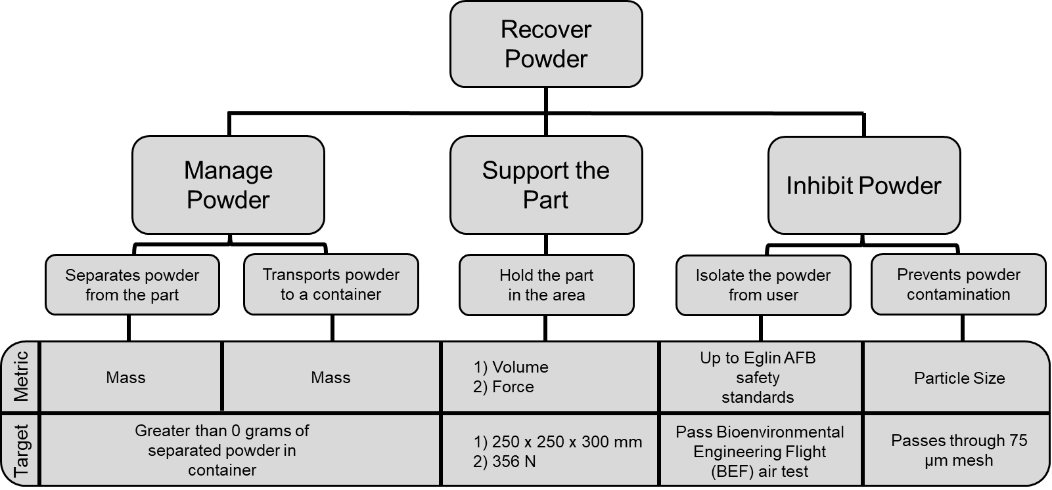
T501: Powder Recovery for Metal Additive Manufacturing
Joshua Dorfman | Vincent Giannetti | Arlan Ohrt | Kevin Richter | Noah Tipton We would like to thank our: Sponsor: Dr. Philip Flater Advisor: Dr. Simone Hruda
Project Description
Project Background
The objective of this project is to design a device which increases the amount of recovered steel powder in a metal additive manufacturing process. This device should be compatible with existing hardware and processes while ensuring the safety of the operators.
AFRL uses a process known as “Laser Powder Bed Fusion (LPBF)”, which distributes metal powder in an even layer over a buildplate, and then a laser traces a path in the powder to fuse the material together. The process continues, layer by layer, building up a full printed part. This process results in a large amount of unfused powder.
LPBF is used at AFRL in order to create stainless steel parts with complicated lattice structures that could not be manufactured otherwise.
Selected Design
2
2
1
1
3
3
4
5
4
5
6
7
6
7
Future Work

